Slide 1

MILESTONE 1
Webcam Input and Hand Detection Module
Mentor : Dr. D.Bhanu Prakash
Presented by: MAJJI HARI KRISHNA

Slide 2

PROBLEM STATEMENT
➤ Building a computer vision-based application that enables users to control their system volume using predefined hand gestures.
➤ By detecting hand landmarks from a webcam feed using MediaPipe and interpreting the geometric relationships between them, the application translates specific gestures (such as pinch distance) into volume control signals.
3

Slide 3
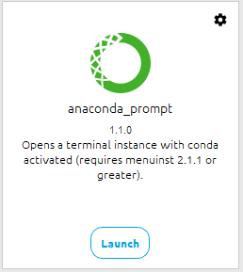
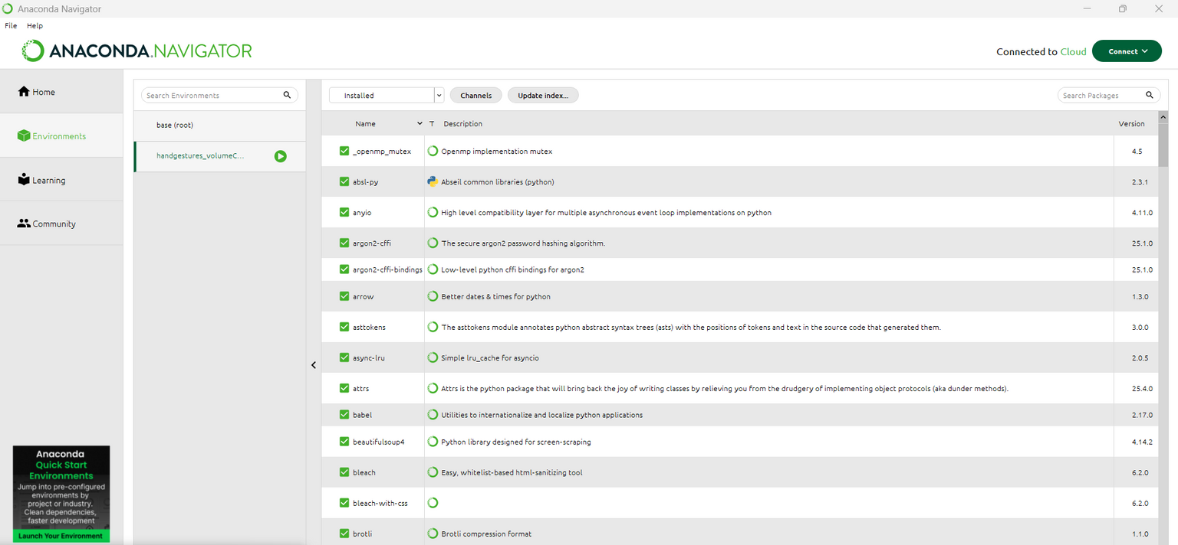
Environment setup
Open Anaconda Prompt (as normal user) and run these commands line-by-line.
1. Create a fresh conda environment with Python 3.10:
>>> conda create -n <Environment Name > python=3.10 -y
>>> conda activate <Environment Name >
2. (Recommended) make sure conda-forge channel is available for packages:
>>> conda config --add channels conda-forge
>>> conda config --set channel_priority flexible
3

Slide 4
3. Install Jupyter Notebook + Matplotlib via conda (fast, binary):
>>> conda install jupyter notebook matplotlib -y
4. Install a compatible NumPy (choose a stable 1.x release). Example:
>>> pip install numpy==1.26.4
(We pin NumPy to a 1.x series because MediaPipe currently requires numpy < 2.)
5. Install OpenCV (pip install the wheel). Using pip ensures you get the official opencv-python wheel:
>>> pip install opencv-python
6. Install MediaPipe (pip). MediaPipe provides Python wheels install after NumPy is set to 1.x:
>>> pip install mediapipe
If you want a specific recent version:
>>> pip install mediapipe==0.10.21
7. (Optional, but recommended) install opencv-contrib-python
if you need extra modules:
>>> pip install opencv-contrib-python
3

Slide 5
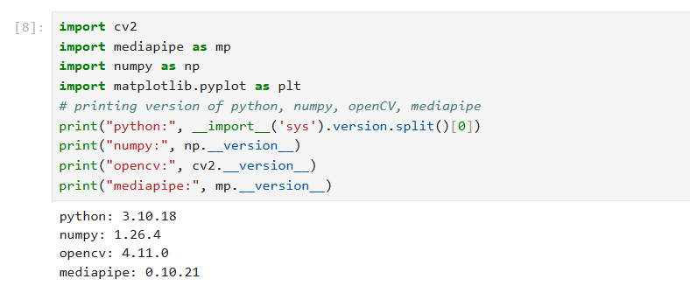
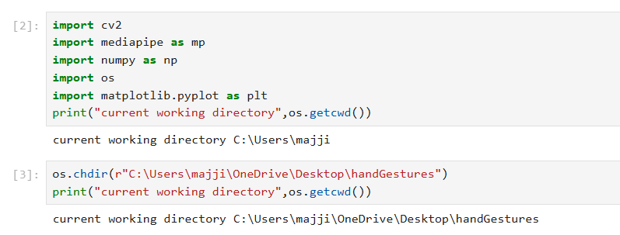
8. Verify installs quickly (run in the same environment):
>>> import sys, numpy as np, cv2, mediapipe as mp, matplotlib print('python', sys.version.split()[0])
>>>print('numpy', np. version)
>>>print('opencv', cv2. _version_)
>>>print('mediapipe', mp. _version_)
9. test the environment (run inside the env / Jupyter) : Open Jupyter Notebook
10. Check current working directory and change the directory
3

Slide 6
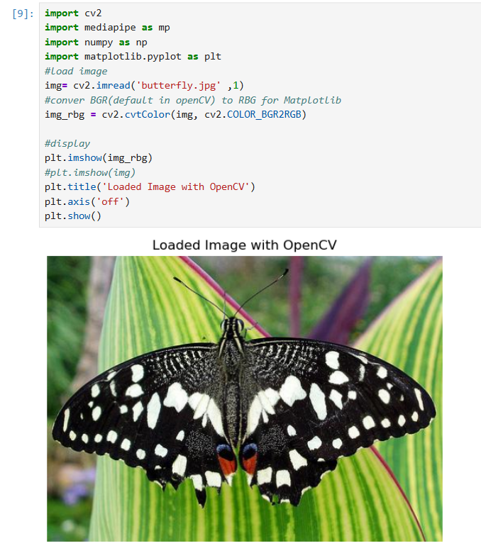
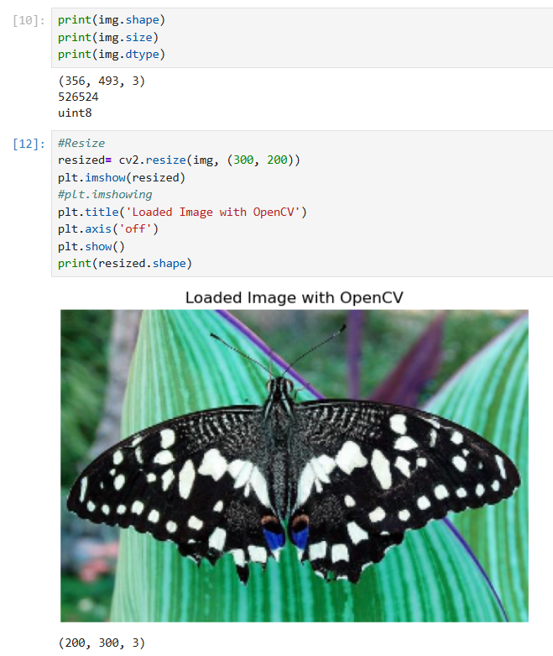
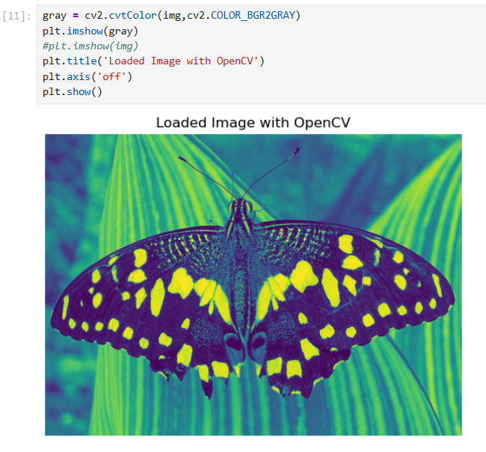
Images in OpenCV
Load and Display Image
Shape and Resize
BGR to Gray scale
img = cv2.imread('//path//' , -1/0/1)
3
-1 -> cv2.IMREAD_COLOR : loads a color image. It is the default flag.
0 -> cv2.IMREAD_GRAYSCALE : Loads image in grayscale module
1 -> cv2.IMREAD_UNCHANGED : Loads image as such including alpha channel

Slide 7
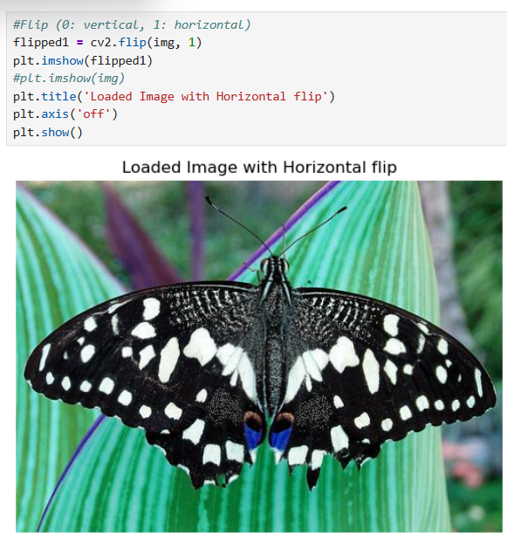
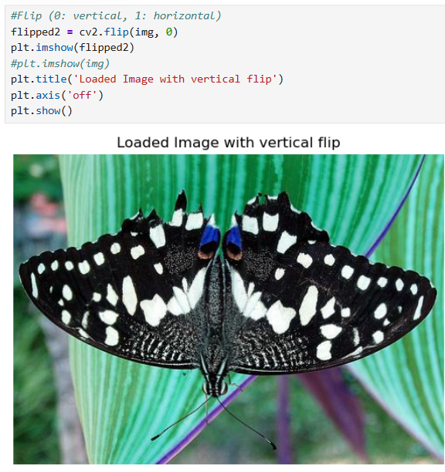
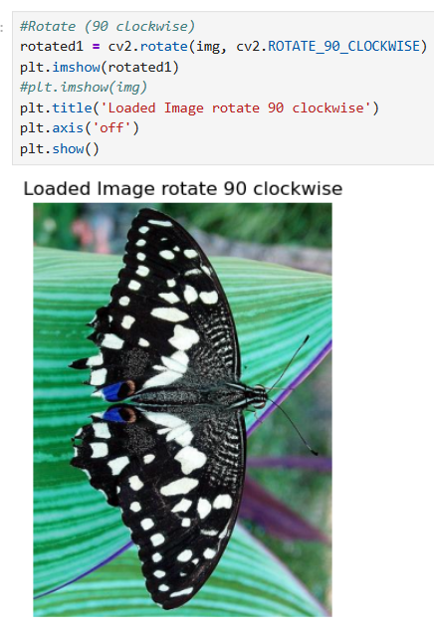
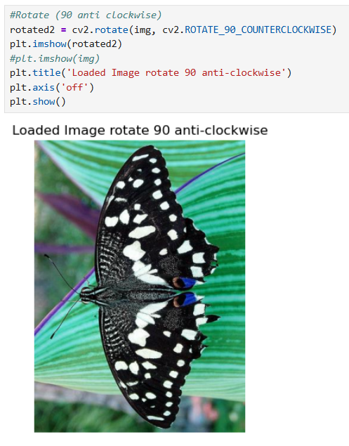
Rotate and Display Image
Flip and Display Image
img = cv2.rotate(img, flag)
flags:
cv2.ROTATE_180
cv2.ROTATE_90_CLOCKWISE
cv2.ROTATE_90_COUNTERCLOCKWISE
7

Slide 8
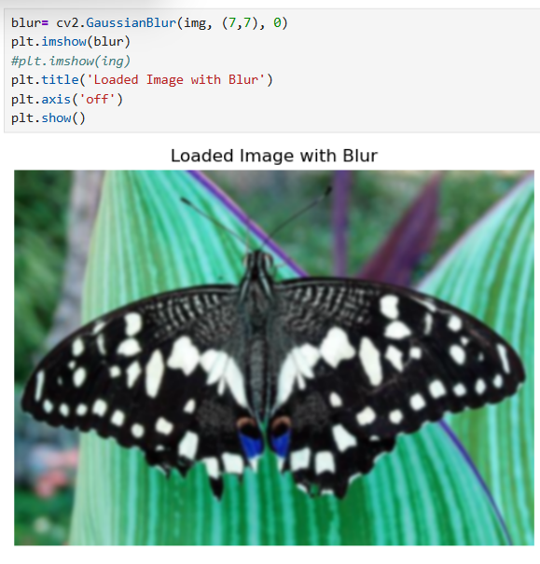
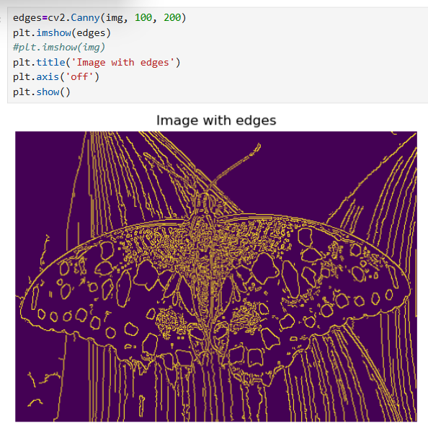
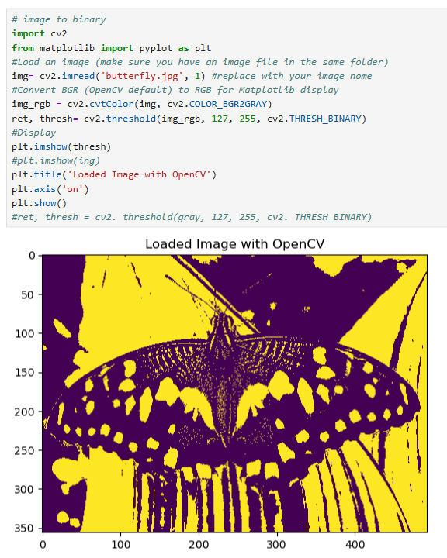
Image Processing Techniques
Blurring
Edges, Image outline Detection
Binary Image
7

Slide 9
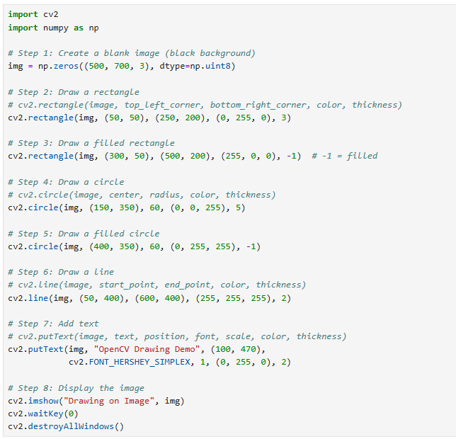
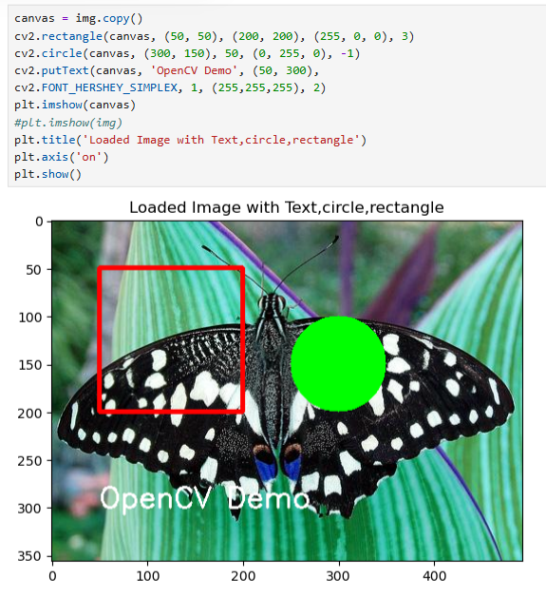
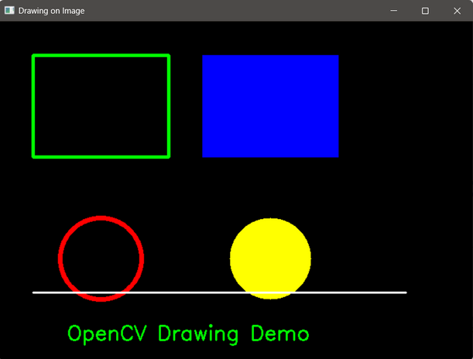
Drawing and Text
cv2.rectangle(img, pt1, pt2, color, thickness)
cv2.circle(img, center, radius, color, thickness) draws a circle.
cv2.putText(img, text, org, font, fontScale, color, thickness)

Slide 10
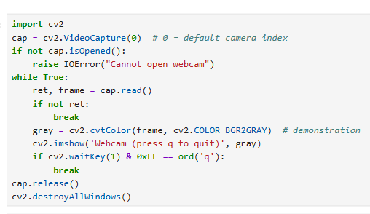
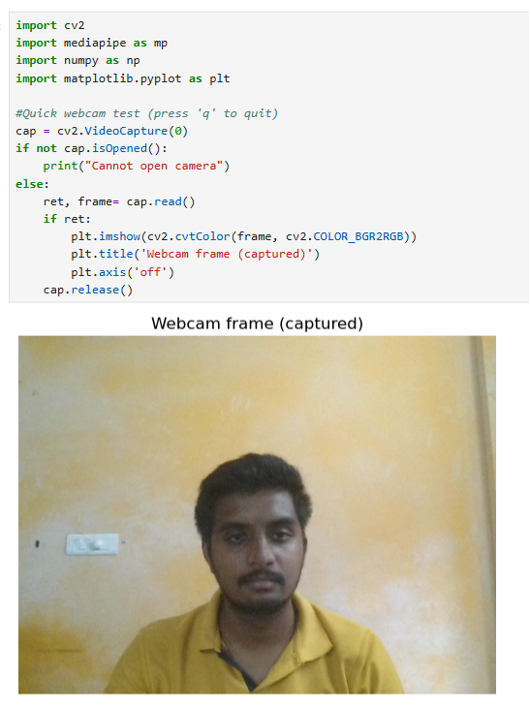
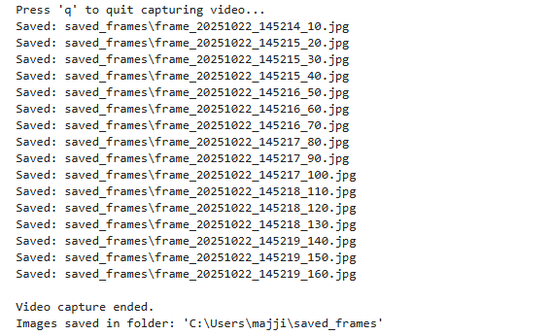
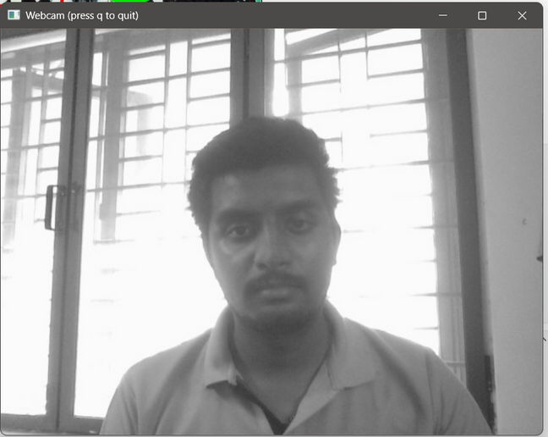
Video Captute in OpenCV
Video Capturing
Image Capturing
Capturing and storing Frames

Slide 11
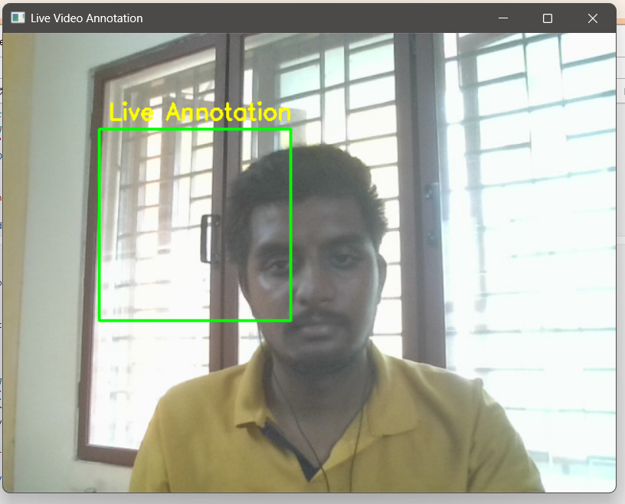
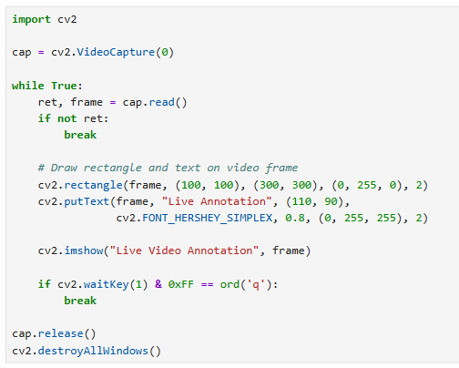
Draw rectangle and text on video frame

Slide 12
THANK YOU

